Slide 1
Good morning!!!
We’ll start at 09:45. Until then, make yourself comfortable!
If you don’t already have a Microsoft Account, get one here: account.microsoft.com
All the exercises will be performed on your own device in a web browser. Start by cloning two Azure Notebooks:
https://notebooks.azure.com/sguthals/projects/data-science-2

Slide 2
Web Development Fundamentals 1
January 2020
Microsoft Reactor |San Francisco
#ReactorSanFrancisco

Slide 3
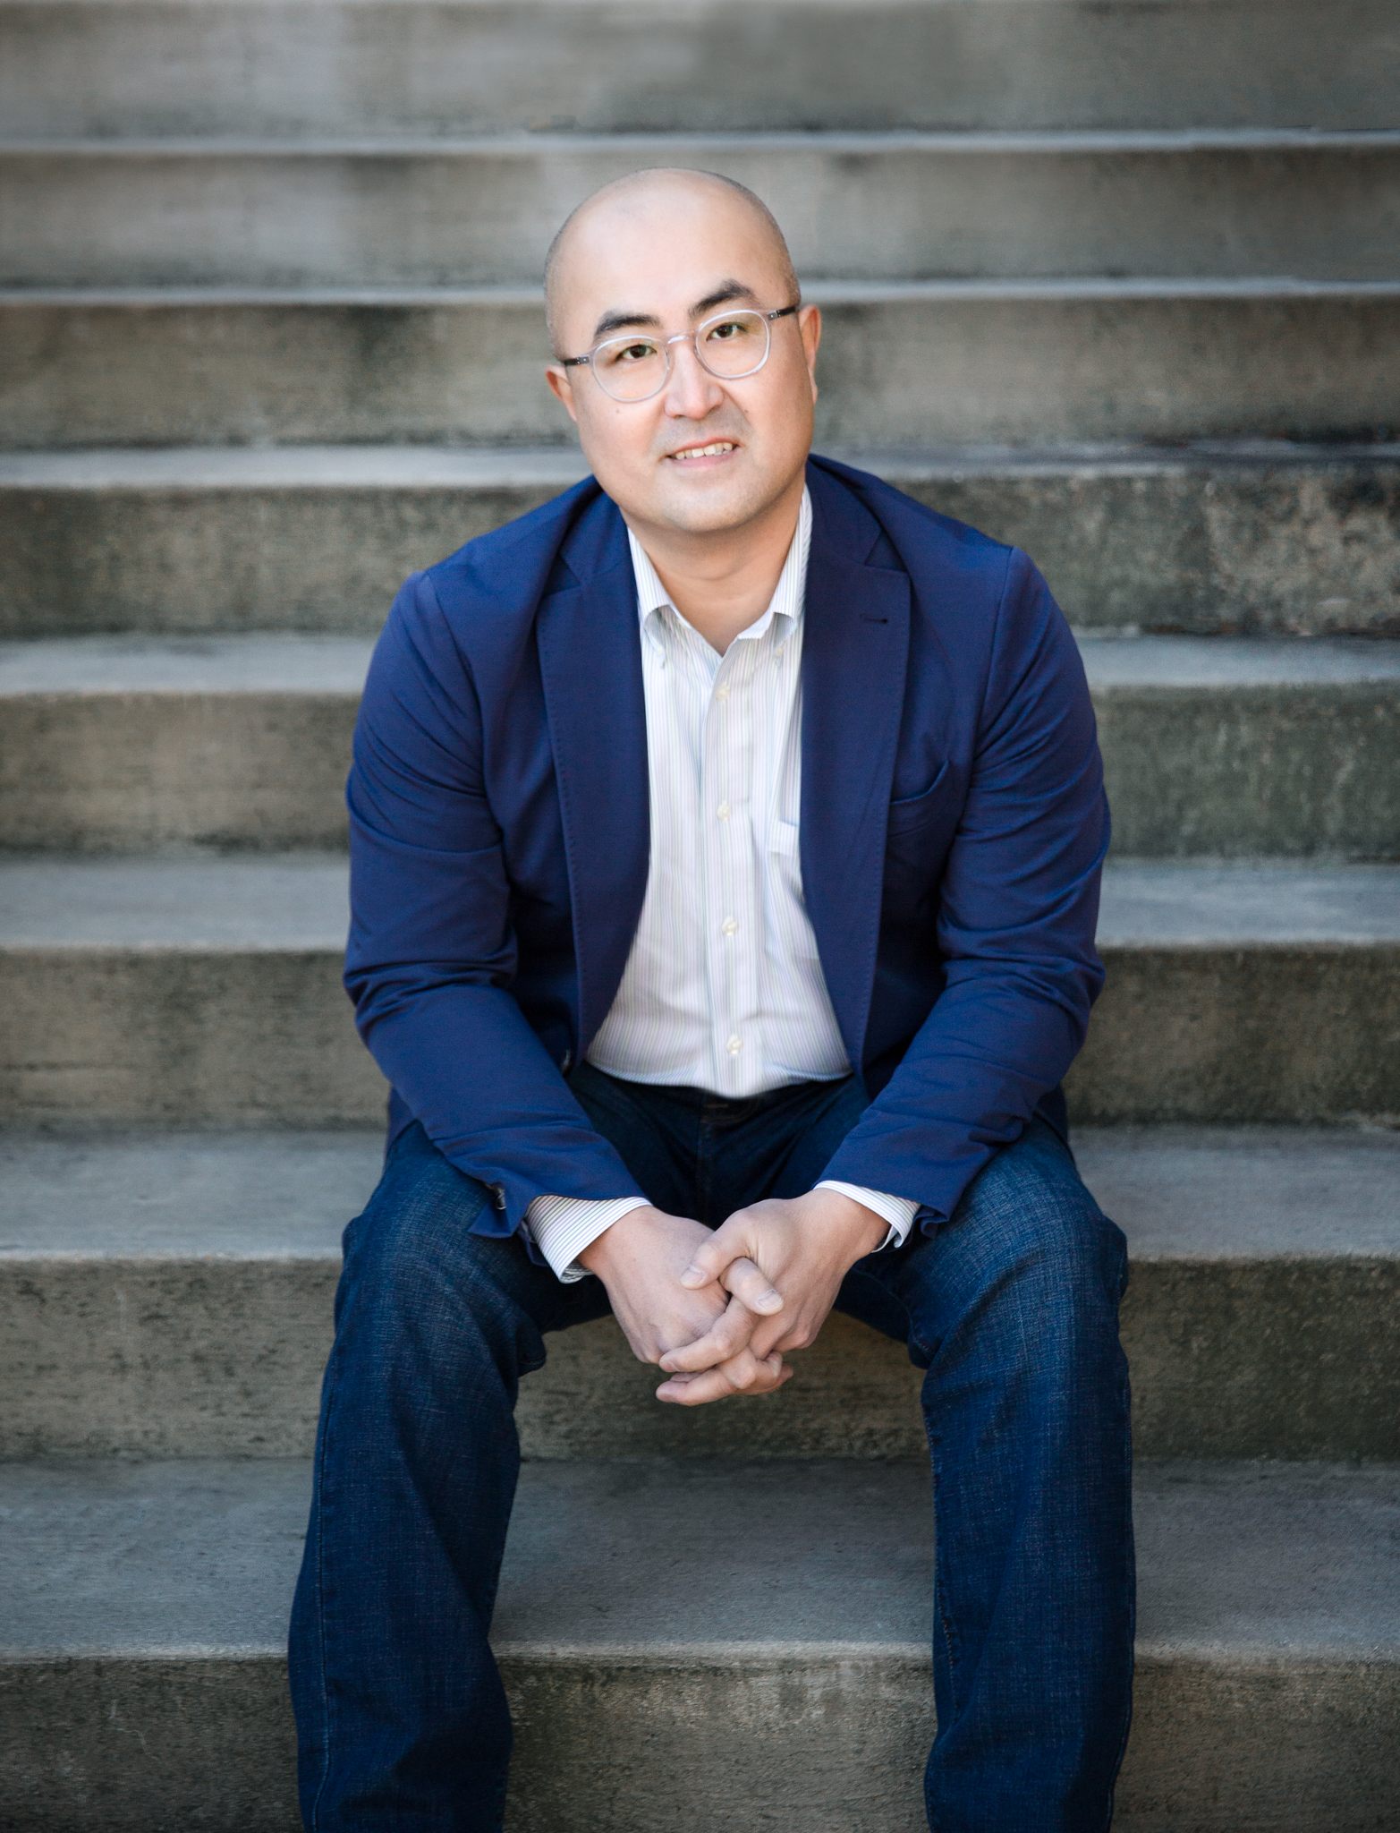
Daniel H. Oostra
Data Scientist, Tech Evangelist Coding Dojo
@danoostra on Twitter and @danieloostra on LinkedIn
daniel@codingdojo.com
Notes:
Grew up in Chicago
Hacker @ age 13, arrested age 15
Played College Tennis
USAF Space Command
Professional Musician/Slovak Rock Star
Worked for NASA LaRC
Lead Instructor, DO, Managing Director

Slide 4

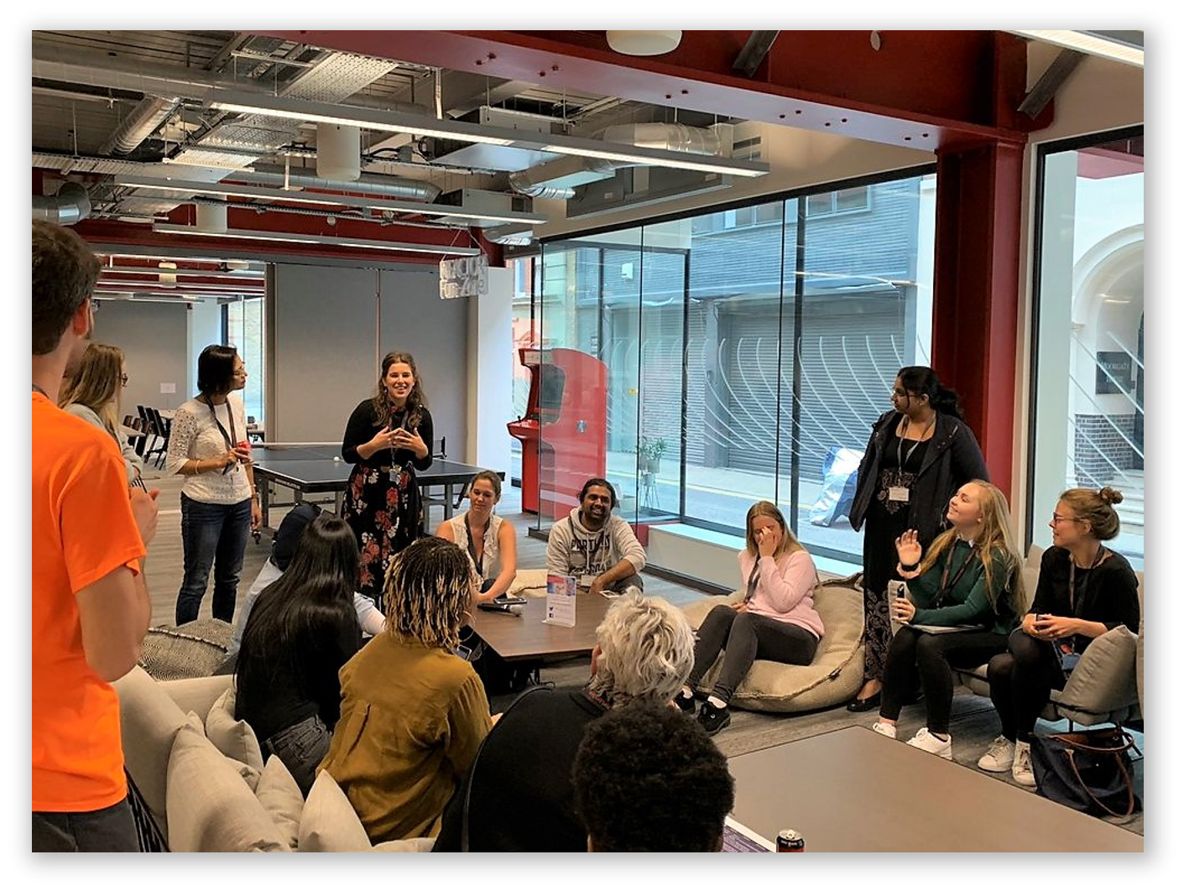
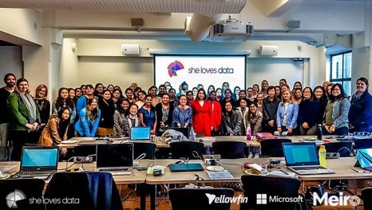
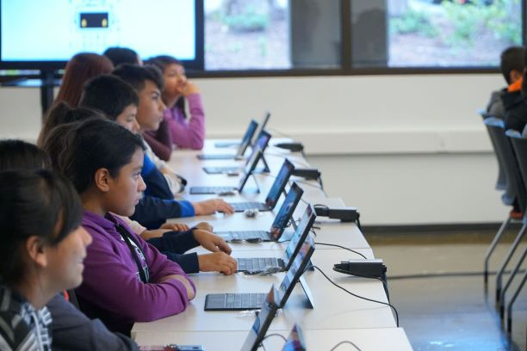
developer.microsoft.com/reactor/
@MSFTReactor on Twitter
Notes:
Welcome to your <location> Microsoft Reactors. We are worldwide local community spaces where developers and startup leaders meet, learn, and connect. Reactors build a diverse community by providing training, learning paths, industry speakers, and seminars, plus meetups and other community events related to emerging technology trends.
Reactor learning, networking, and leadership opportunities are designed to focus on real-world challenges to enable members of the tech community to stay up to date and drive solutions. Reactors are a place to share knowledge and expand impact in the company of technology enthusiasts locally and globally.
We have workshops and other learning opportunities planned throughout the year. Or if you want to host your own event at a Reactor, you can make the request on our website.

Slide 5

Notes on Learning how to Learn
The “Cycle of Learning”
Know why you are learning something.
Work in short highly active and focused periods.
Take a break
Review what just learned before starting something new.
Make connections
Write our experiences to our long term memory
Concept
Concept
Concept
Your Brain

Slide 6
Workshop Agenda
10:00 am | Introduction to Data Science Keynote
10:30 am | Manipulating & cleaning data
11:30 am | Review and Working Lunch
12:00 pm | Machine Learning Models and Linear Regression
1:00 pm | Using the Cloud for Machine Learning with Azure ML Studio
2:30 pm | Capstone Project
3:45 pm | Wrap Up and Next Steps

Slide 7
Capstone project

Slide 8
Additional Learning Resources and Next Steps

Slide 9
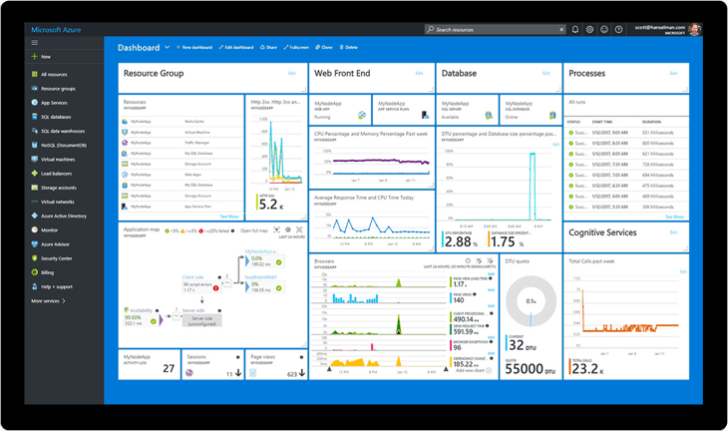
Free Azure for your next experiment…
azure.microsoft.com/free/
azure.microsoft.com/free/students/
Notes:
https://azure.microsoft.com/free/
Pros: $200 for 30 days + Always Free Tier
https://azure.microsoft.com/free/students/
Students: $100 for 12 months + Always Free Tier

Slide 10
Further Learning in Data Science…
Microsoft Learn has free learning in a cloud sandbox:
Good refresher on what we covered in this workshop: docs.microsoft.com/learn/paths/intro-to-ml-with-python/
More on the Data Science methodology and best practices: docs.microsoft.com/learn/paths/explore-data-science-tools-in-azure/
Take the next step in building ML models: docs.microsoft.com/learn/paths/build-ai-solutions-with-azure-ml-service/
Experiment with Data Science Virtual Machine: docs.microsoft.com/learn/paths/get-started-with-azure-dsvm/
Learn more about what Azure can do: docs.microsoft.com/learn/paths/azure-fundamentals/

Slide 11
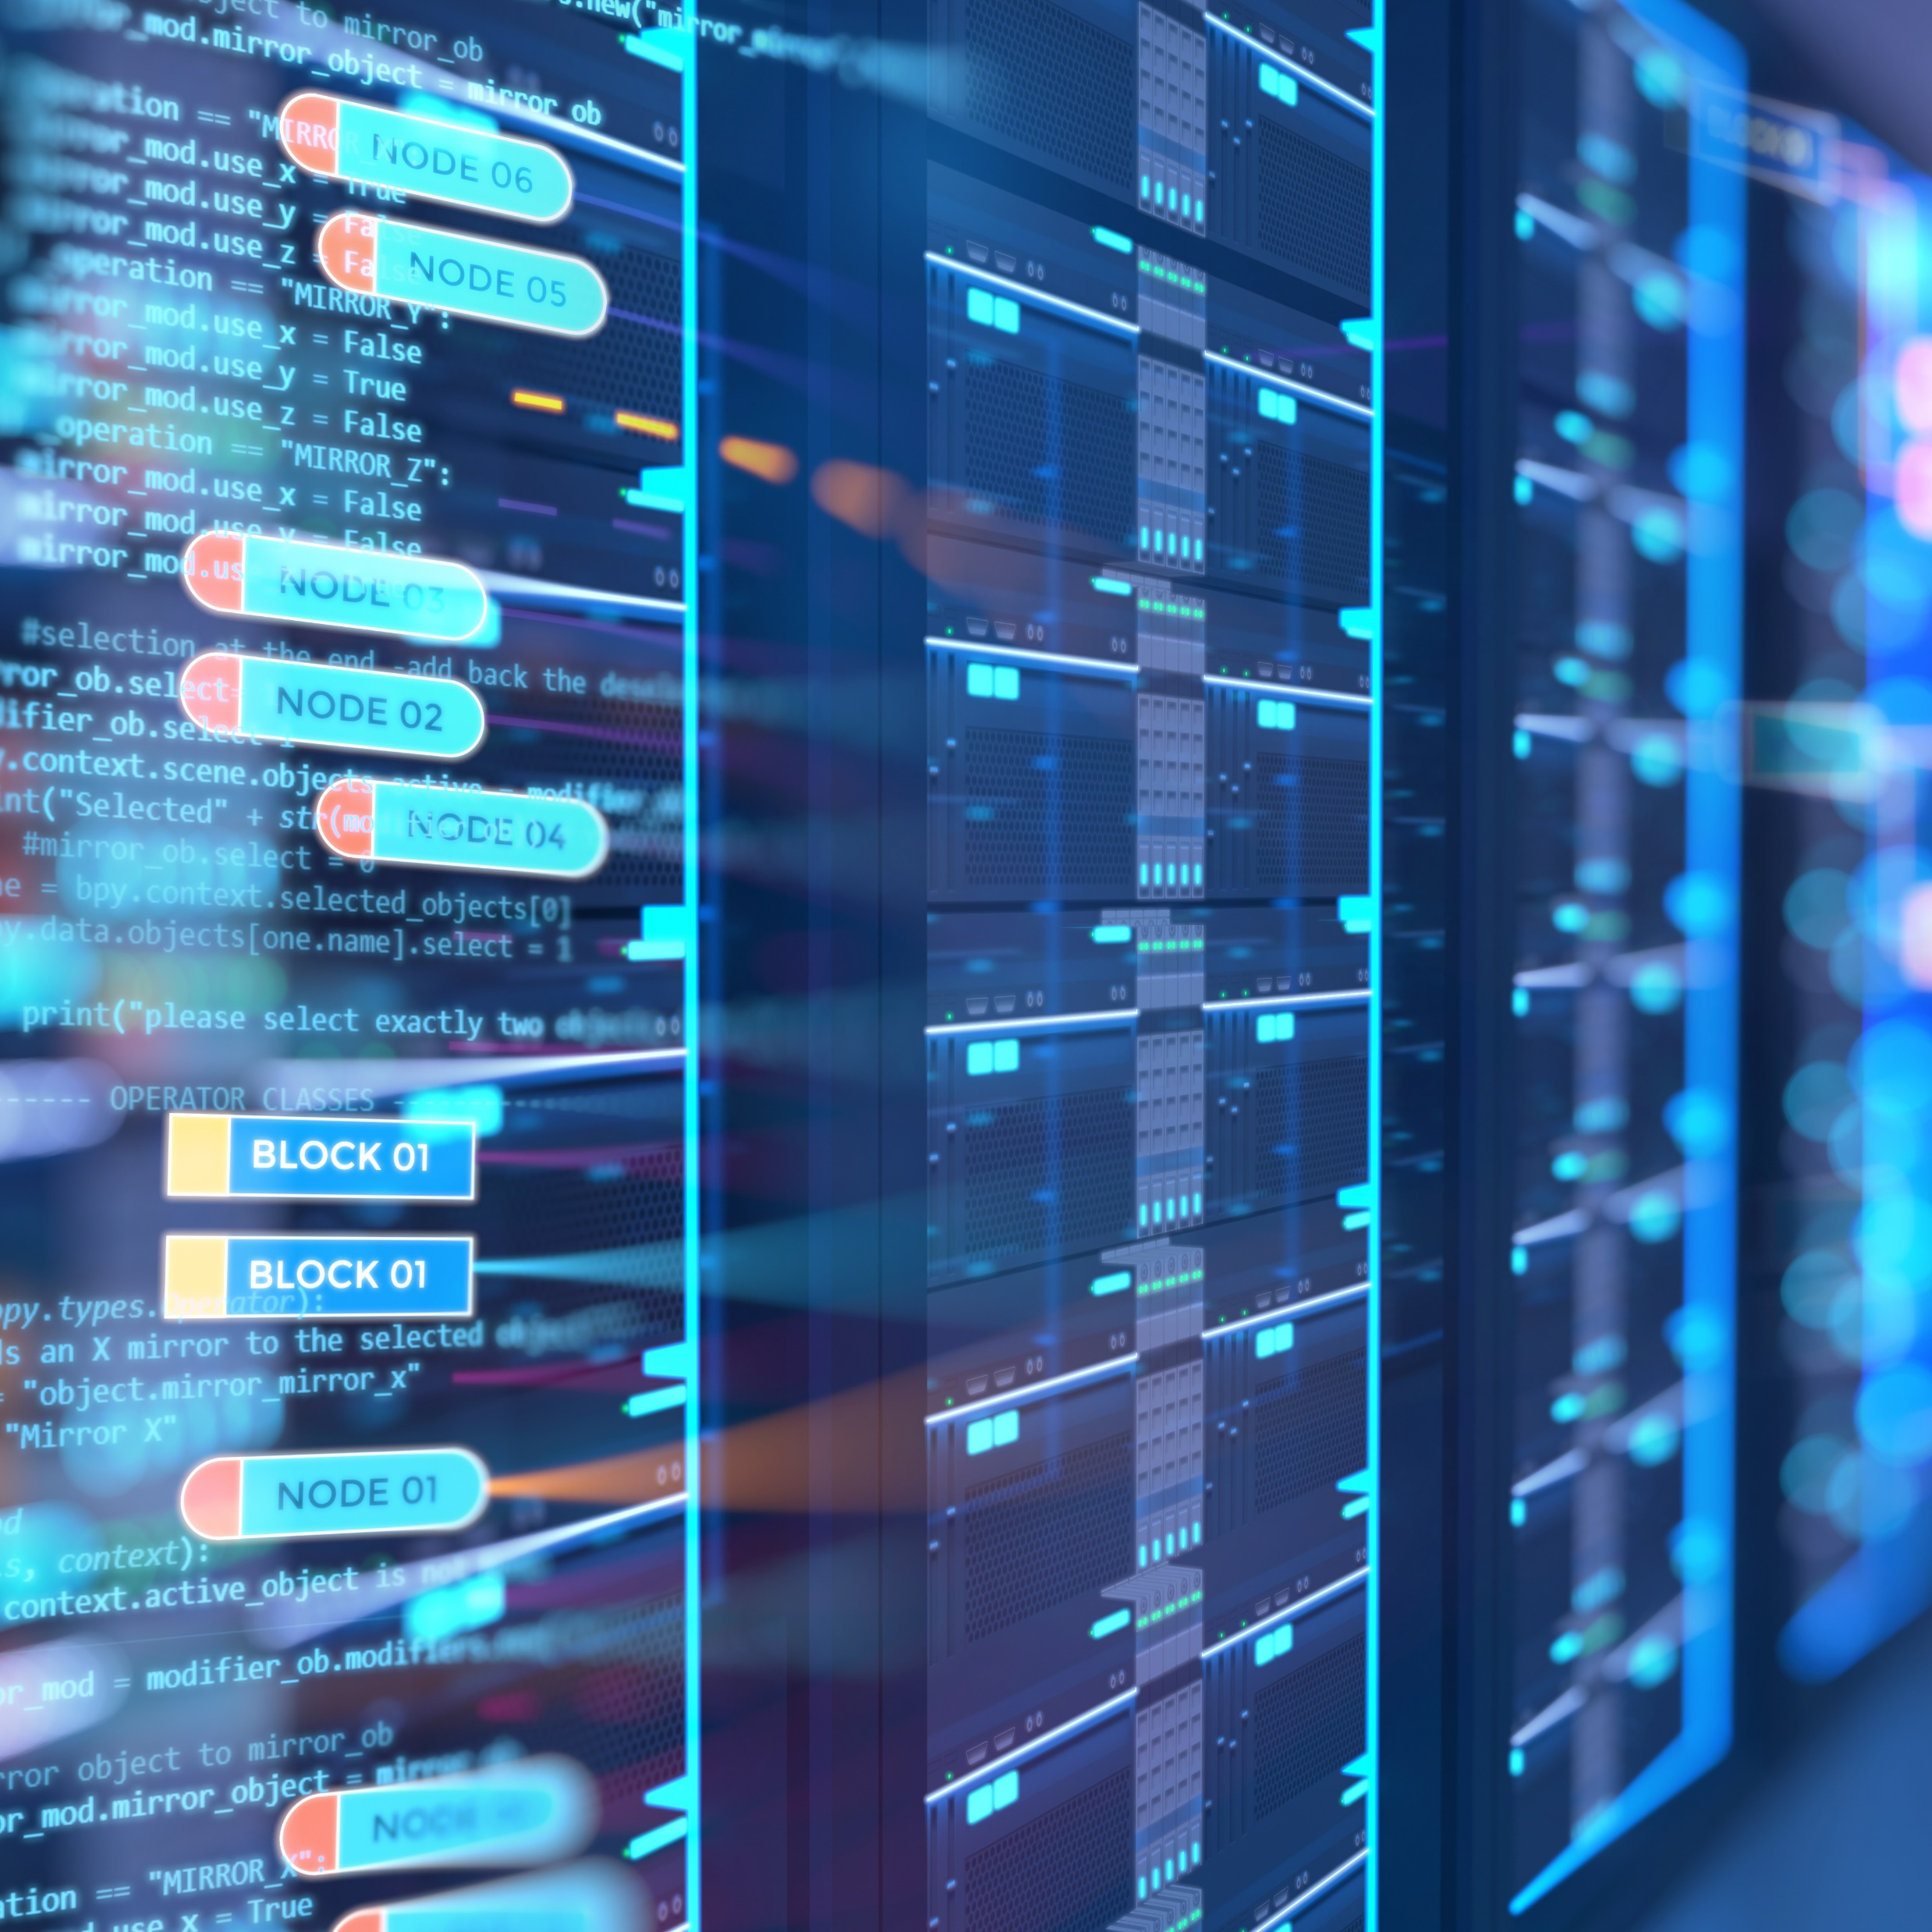
Role-based Microsoft certs:
In the data sciences:
Azure Data Engineer Associate
Azure Data Scientist Associate
Azure Developer Associate
Also…
Azure Fundamentals
Azure AI Engineer Associate

Slide 12
developer.microsoft.com/reactor/
@MSFTReactor on Twitter
Notes:
Thank you!

Slide 13
© 2019 Microsoft Corporation. All rights reserved. The text in this document is available under the Creative Commons Attribution 3.0 License, additional terms may apply. All other content contained in this document (including, without limitation, trademarks, logos, images, etc.) are not included within the Creative Commons license grant. This document does not provide you with any legal rights to any intellectual property in any Microsoft product. You may copy and use this document for your internal, reference purposes.
This document is provided "as-is." Information and views expressed in this document, including URL and other Internet Web site references, may change without notice. You bear the risk of using it. Some examples are for illustration only and are fictitious. No real association is intended or inferred. Microsoft makes no warranties, express or implied, with respect to the information provided here.

